Slide 1
Hodges Village Dam
Master Plan Revision
Public Involvement Presentation
August 1, 2024
Notes:
Hello, my name is Josh Quiring, and I am the Project Manager for the Hodges Village Dam Master Plan Revision.
On behalf of the US Army Corps of Engineers, we would like to welcome you to the Public Involvement Presentation for the master plan at Hodges Village Dam. Public and stakeholder involvement is critical to the success of the revision. Thank you for taking the time to attend this meeting.

Slide 2
Purpose of the Presentation
Inform the public and stakeholders that a master plan revision has started
Define a master plan
Describe the master plan revision process
Provide instructions on how to participate in the revision process
Encourage participation
Provide links to documents
The Corps defines a Master Plan as…
    “The strategic land use management document that guides the comprehensive
    management and development of all project recreational, natural and
    cultural resources throughout the life of the water resource development project.”
Source: Chapter 3 of EP 1130-2-550 available at
www.usace.army.mil/library/publications
Notes:
The purpose of this presentation is to inform the public and stakeholders that a master plan revision has started at Hodges Village Dam. This presentation will define a master plan, describe the master plan revision process, provide instructions on how to participate in the process, and encourage participation. It will also provide links to documents and details about how to contact the Corps to ask questions.
The information provided through public and stakeholder comments is essential to the decision-making process of how project lands and water surfaces will be classified and managed. The Corps wants your ideas and comments. After watching this presentation, review the other material on the project website and send in comments and participate in planning the future of Hodges Village Dam.

Slide 3
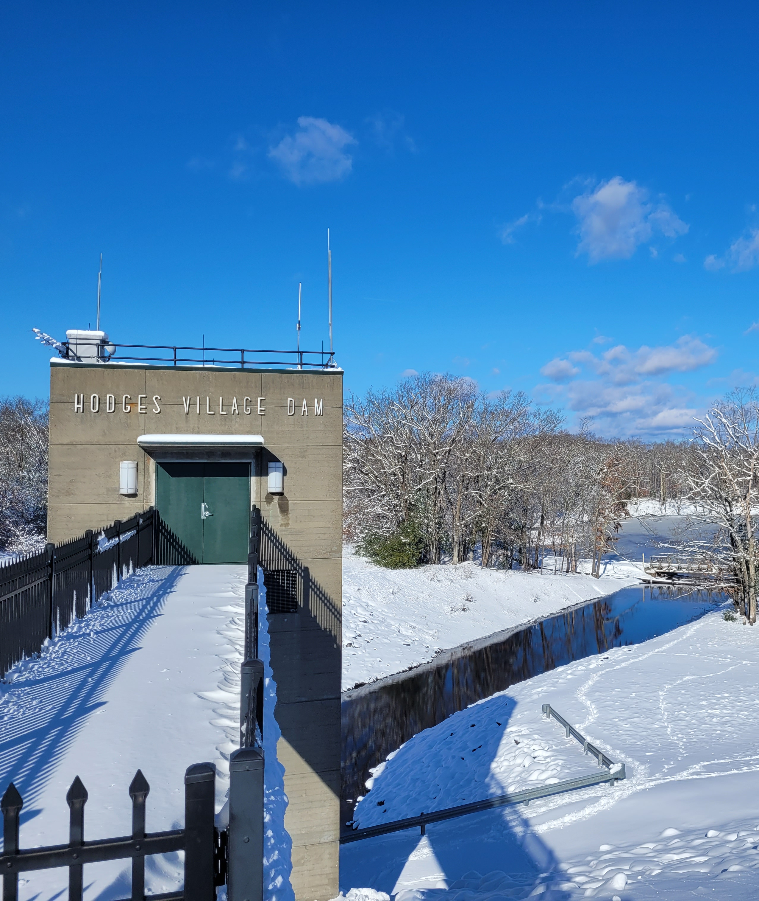
Presentation Topics
▶ What is a Master Plan?
▶ Why do a revision?
▶ What is the revision process?
▶ What about the current (1976) Master Plan?
▶ What about NEPA compliance?
▶ What is NOT part of a Master Plan?
▶ What is changing in the Master Plan?
▶ How can I participate?
▶ Who can I talk to about the plan?
▶ When will the Master Plan be completed?
Notes:
Topics to be covered in this presentation are summed up under these questions that are often asked in a public meeting or workshop:
What is the revision process?
What is a Master Plan? And what is changing in the Master Plan?
What about NEPA compliance?
What is NOT part of a Master Plan?
How can I participate?
Who can I talk to about the plan?
When will the Plans be done?
Under each of these topics, this presentation will provide details to help you better understand the revision and your role in the process.

Slide 4
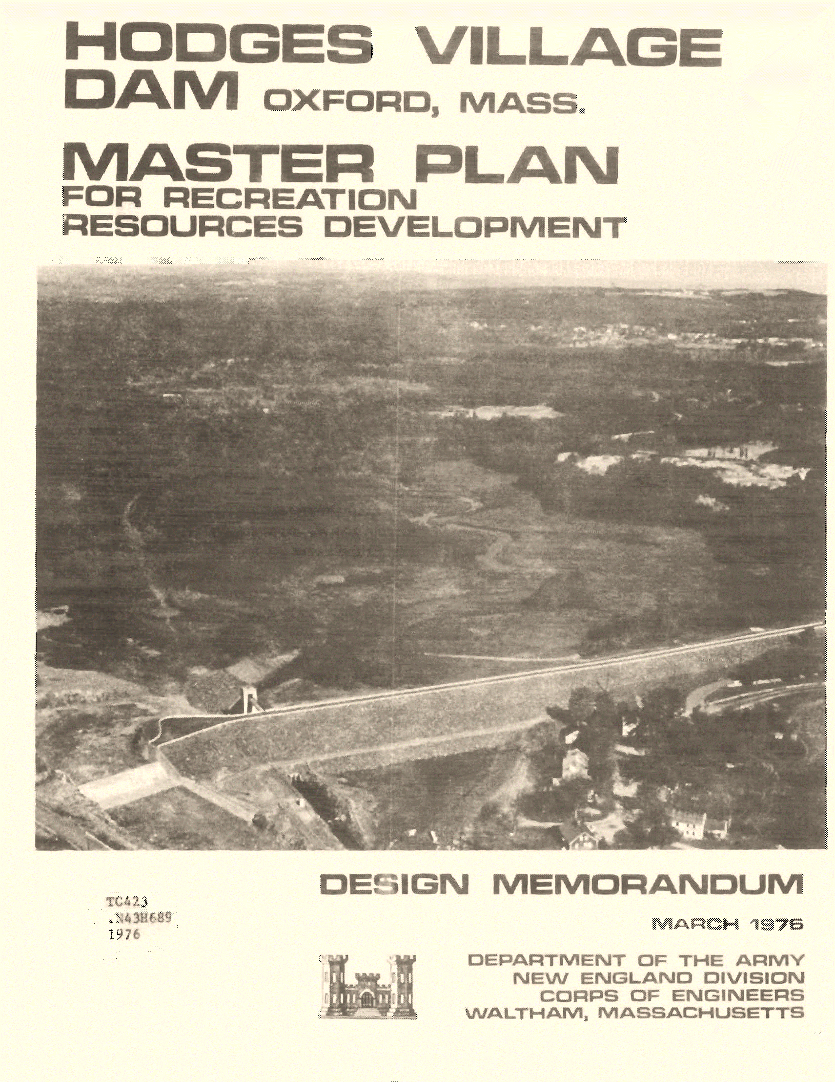
What is a Master Plan?
The Master Plan (MP) is a 25-year comprehensive land use management guide for recreational, natural, and cultural resources
Adheres to Federal laws to preserve, conserve, restore, maintain, manage, and develop project lands, waters, and associated resources, including the National Environmental Policy Act (NEPA) for environmental stewardship and outdoor recreation
Provides land classifications and resource management objectives that are broad and adaptive over time
Requires and encourages public involvement
See Engineering Regulation (ER) and Engineering Pamphlet (EP) 1130-2-550 for regulations and policy guidance related to the MP
Notes:
What is a Master Plan?
The Corps defines a Master Plan as… “The strategic land use management document that guides the comprehensive management and development of all project recreational, natural and cultural resources throughout the life of the water resource development project.”
The master plan is the document that will guide the land use and management of the project for the next 25 years, while adhering to all applicable Federal laws including the National Environmental Policy Act, or NEPA. The focus of the plan is the designation of land classifications with corresponding management plans, as well as establishing resource management objectives. The previous Master Plan was from 1976.
The key to a successful master plan is public involvement, which you can help by providing written comments!

Slide 5

Why do a revision?
The current master plan is out of date and is no longer compliant with existing laws and regulations
Substantial changes in environmental, cultural, social, and recreational conditions have occurred since the current master plan was approved
Re-examine land classification due to these substantial changes
The master plan provides long-term goals and consistent management objectives to guide balanced management of resources and public recreation
Notes:
Why is the Corps doing a revision to the master plan at this time?
The Corps is undergoing master plan revisions at many of their projects nationwide as existing plans are no long compliant with current laws and regulations. Many projects have also been influenced by changes in the surrounding environment, either by increased urbanization and growth, or changes in rural patterns of land use. As change is ever constant, an update to the plan is needed to capture how the project land classifications meet the current and future projected uses. Not only does land use change, but also management resources in terms of personnel over time, the master plan provides stability, with long-term goals, and a consistent management strategy, for project resources.

Slide 6
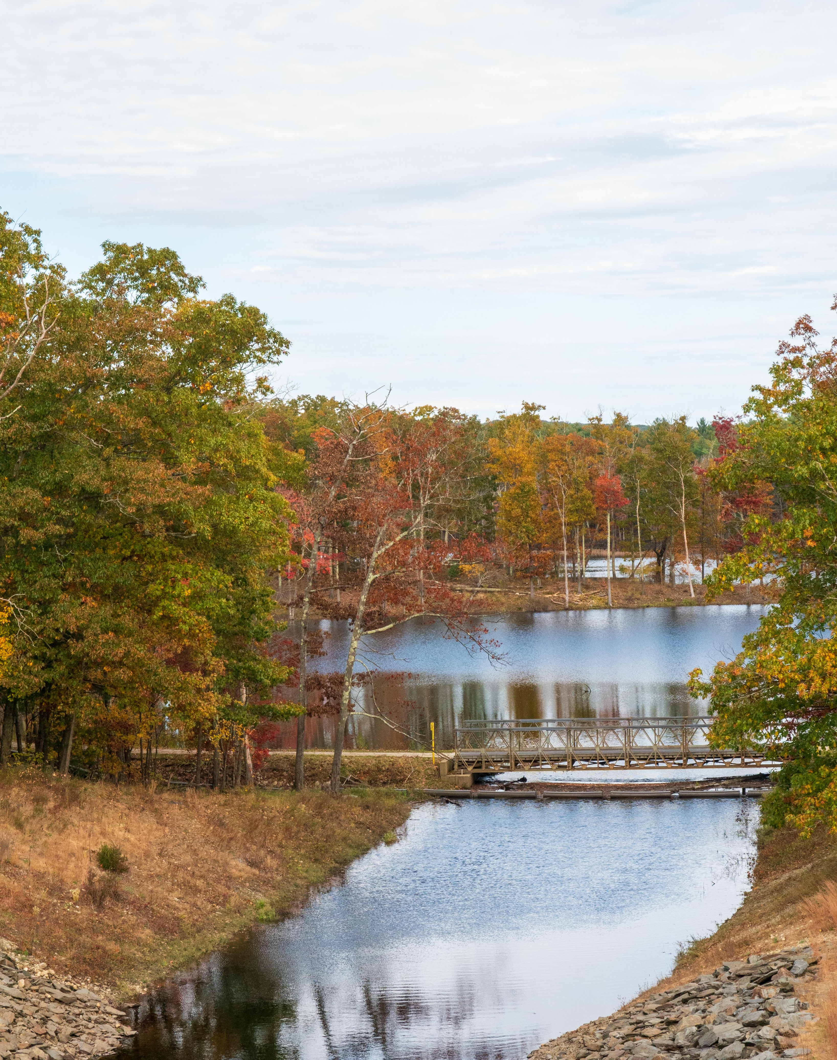
What is the revision process?
The process is a cover-to-cover review and revision of the entire plan and is accomplished by:
  A team of Corps employees including Operations, Real Estate, Master Planning, and Environmental Compliance subject matter experts
  Receive input from and collaboration with partners, neighbors, stakeholders, elected officials, resource agencies, and the public
  A thorough review and update of land and water surface classifications
  Developing appropriate NEPA compliance documents
Notes:
The revision process includes a cover-to-cover review and update of the entire plan. The revision involves input from the public and stakeholders but is compiled and completed by a team of Corps employees from a wide array of disciplines. Operations, Real Estate, Master Planning and Environmental Compliance are a few of the subjects where expertise is needed. The revision process will review all of the land and water surface classifications and recommend changes as appropriate. The revision process is a federal action that requires compliance with NEPA, and the appropriate documentation will be a part of the plan.

Slide 7
Where are we in the Revision process?
Project Initiation/Data Collection
Agency/Public Scoping Notification & Comment Period (30 days)
PHASE 1
SCOPING
Development of Draft
MP Report and EA
Agency/Public Draft Document Notification & Comment Period (30 days)
PHASE 2
DRAFT
Development of Final MP Report and EA
Publish Final MP Report and EA
PHASE 3
FINAL
Where we are today
Notes:
The revision process includes 3 phases: (scoping, draft and final)
The scoping phase is when the federal agency asks for initial input from other agencies, citizens and organizations regarding project area, resources and uses. This is the phase we are currently in, as noted by the yellow star on the chart.
The draft phase is when USACE considers public comments on the proposed recommendations in the draft master plan documents. After completing the 30-day comment period we will begin the final phase.
The final phase is when USACE incorporates public comments from the draft review into a final master plan .
The plan is published after formal approval by the District Commander.

Slide 8
What is the revision process?
Land Classifications
Source: Engineering Pamphlet (EP) 1130-2-550
Land Classification | Definition
Project Operations | Lands required for the dam, spillway, levees, office, maintenance facilities and other areas that are used solely for project operations.
High Density Recreation | Land developed for intensive recreational activities for the visiting public, including day use areas and campground areas for commercial concessions, and quasi-public development.
Multiple Resource Management Lands | Low Density Recreation: Lands with minimal development or infrastructure that support passive public recreational use (e.g., trails, primitive camping, wildlife observation, fishing and hunting).
 | Wildlife Management: Lands designated for the stewardship of fish and wildlife resources.
 | Vegetative Management: Lands designated for the stewardship of forest, prairie, and other native vegetative cover.
 | Inactive and/or Future Recreation Areas: Recreation areas planned for the future or that have been temporarily closed.
Environmentally Sensitive Areas | Areas where scientific, ecological, cultural or aesthetic features have been identified. These areas must be considered by management to ensure they are not adversely impacted.
Mitigation | Lands acquired or designated specifically for offsetting losses associated with development of the project. Lands allocated as separable mitigation lands can only be given this classification.
Notes:
The Corps defines land classification as the primary use for which project lands are managed. All Federally owned lands are zoned for development and resource management consistent with project purposes.
Utilizing the current Federal guidance, the land classifications are defined as shown in this table.
The Project Operations classification is used solely for lands dedicated for the operation of the project, including the dam, spillway, levees, project office, and other operational features.
The classification High Density Recreation is assigned to lands that are being used for intensive recreational activities, including day use and campground areas.
The Multiple Resource Management Lands allows for the designation of a predominate use and are subdivided into 4 classifications. All 4 classifications essentially allow for similar activities to occur, but are managed with a particular emphasis, including low density recreation, wildlife management, vegetative management, and inactive or future recreation areas.
The protection of Environmentally Sensitive Areas is given priority, and are for lands with unique scientific, ecological, cultural, or aesthetic features. Examples include endangered species habitat, scenic shorelines, and rare and unique plant communities to mention a few.
The Mitigation classification is reserved for lands acquired or designated for offsetting losses associated with the development of the project.

Slide 9
What is the revision process?
Water Surface Classifications
Source: Engineering Pamphlet (EP) 1130-2-550
Water Surface Classification | Definition
Open Recreation | Those waters available for year-round or seasonal water-based recreational use.
Restricted | Water areas restricted for project operations, safety, and security purposes.
Designated No-Wake | To protect environmentally sensitive shoreline areas, recreational water access areas from disturbance, and for public safety.
Fish and Wildlife Sanctuary | Annual or seasonal restrictions on areas to protect fish and wildlife species during periods of migration, resting, feeding, nesting, and/or spawning.
Notes:
Water surface classifications are defined much like land classifications in that they reflect how the water surface is to be managed.
The water surface will be reviewed and classified using 4 classifications.
The dominate classification is typically open recreation which allows year-round use of the water surface. The other 3 classifications place restrictions on the water surface based on safety, access, shoreline protection, and wildlife needs.
Restricted water surfaces do not allow access due to safety and security purposes.
No-wake water surfaces limit vessel speeds to protect shorelines from wake damage and are used near marina and boat ramps for public safety.
Fish and wildlife sanctuary water surfaces can be employed on an annual or seasonal basis to restrict access to protect fish and wildlife species.

Slide 10
What is in the current Master Plan?
The most recent approved Master Plan was in 1976 with land and water classifications.
The Master Plan and map can be downloaded from the website at the link provided.
The plan includes a site history and description, natural and cultural resources, and factors affecting management in 1976.
The previous plan included detailed facility plans that are now part of other operational plans.
Notes:
The most recent approved master plan was from 1976 and based on laws and regulations of the time. Since much time has passed since the last approved plan, the project has been working with internal updates to stay consistent with changing federal laws and regulations.
In 1976, there were different land and water classifications than those that are defined by Corps regulations.
The previous master plan can be downloaded from the website provided via this presentation, on the comment cards, or the news release.
The plan includes a site history and description, natural and cultural resources, and factors affecting management in 1976.
The previous plan included detailed facility plans that are now part of other operational plans.
In the prior master plan, the acres for land and water surfaces were not defined, and the maps were not as precise as modern mapping technology.
The image here shows part of the map showing the entire Hodges Village Dam. The full map can be downloaded from the website.

Slide 11

What about NEPA Compliance?
The Environmental Assessment
National Environmental Policy Act (NEPA)
Purpose of NEPA is to:
    Ensure federal agencies give proper consideration to the environmental and cultural resources prior to undertaking a federal action
    Involve the Public and stakeholders in the decision-making process
    Document the process by which agencies make informed decisions
  NEPA Process:
    Opportunity for public comments and questions on the potential impacts of proposed federal actions
    Includes comments from other federal, state, and local governments, and Tribal Nations
Notes:
NEPA is the National Environmental Policy Act.
Compliance with NEPA is required during the master plan revision process. NEPA is required so that federal agencies give proper consideration to the environment prior to undertaking a federal action. Scoping during NEPA involves the public in the decision-making process, while documenting the process by which federal agencies make informed decision.
The NEPA process provides the public with the opportunity to ask questions and comment on the potential impacts of proposed federal actions. It also includes comments from other federal, state and local governments, and Tribal Nations.

Slide 12
What is NOT Part of a Master Plan?
Facility design details
Details of daily project administration
Technical aspects of:
    Water management for flood risk management
    Regional water quality
    Water supply
    Water level management
    Hydropower
    Navigation
  Management of Flowage Easement lands
See Engineering Regulation (ER) and Engineering Pamphlet (EP) 1130-2-550 for regulations and policy guidance related to the MP
Notes:
There are topics of public interest that will not be part of the master plan.
They do not include facility designs, daily project administration details, or any technical discussion regarding flood risk management, water quality, water supply, water level management, hydropower, navigation, or flowage easements.

Slide 13
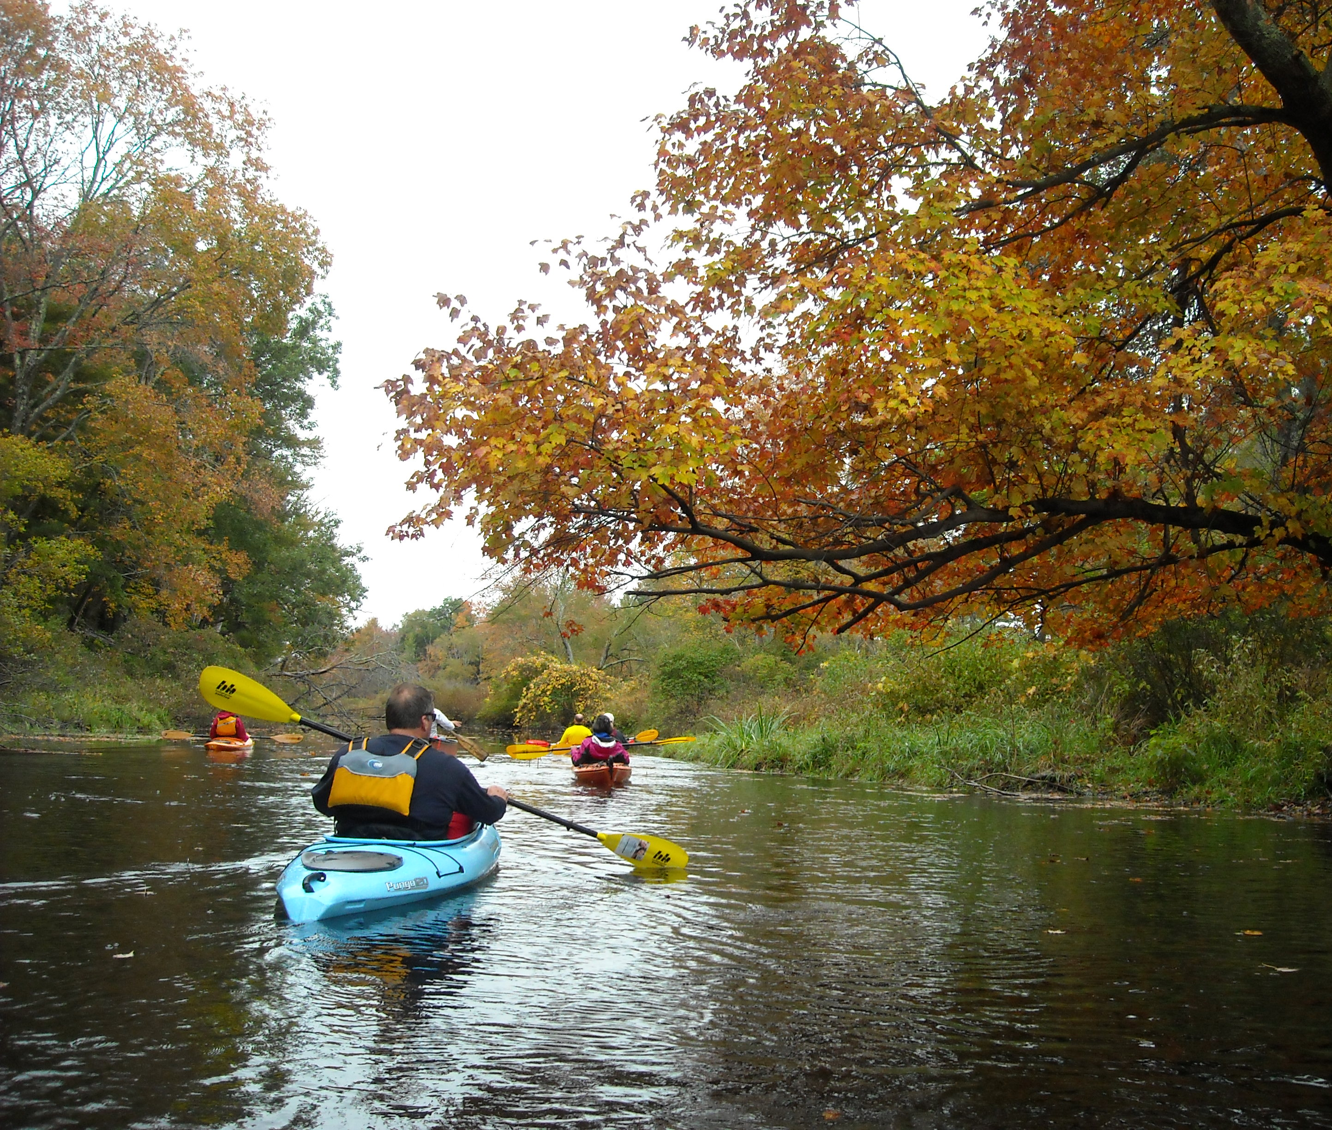
What is changing or Proposed in the MP?
At this point in the revision process there are no proposed changes
The Corps is requesting written comments for RECOMMENDED changes to the existing master plan
Possible Changes to the Revised Master Plan Could Include:
Change Land and Water Classification
Change Resource Goals and Objectives
Create Utility Corridors
Notes:
The master plan will be changing from the current master plan.
However, at this point in the Scoping Phase of the process, nothing has been proposed to change. Scoping is where the federal agency asks for initial input from other agencies, citizens, and organizations regarding project area, resources and uses. The purpose of this public involvement presentation is to inform the Public that the master plan revision has started and collect suggestions and written comment for possible changes to the master plan. Possible changes could include land and water classifications, resource goals and objectives, the creation of utility corridors, and the inclusion of the mitigation area into the main body of the master plan document.

Slide 14

How can I participate?
Submit written comments!
Review all documents available on the USACE website: https://www.nae.usace.army.mil/Missions/Recreation/Hodges-Village-Dam/Hodges-Village-Dam-Master-Plan/
Documents available on the website include:
    Previous Master Plan
    Project map
    Comment form
    Copy of this presentation
Spread the word by telling your colleagues, friends, and neighbors to participate
Scan QR Code
Notes:
You can participate in the process by reviewing the documents available on the website and submit written comments. The Corps will only accept comments in written format. The project website is hosting all the documents relevant to the master plan revision, including the current master plan documents, project maps, comment forms with instructions on how to submit a comment, and copies of this presentation for your review. As the project progresses, and new information is developed, it will be posted to this project website, so you may want to bookmark the site for future reference.
We are asking for your help to spread the word to others, letting them know the master plan revision has been initiated, and this is the opportunity to participate in the process.

Slide 15
How can I participate?
Comments will be accepted only in writing, some of the methods for submitting a comment include:
You may download the comment form provided on the website, fill it out electronically, and email it to the Corps
Or you may print the comment form provided on the website, fill it out by hand, and mail it to the Corps at the address on the comment form
Or you may write a comment or send an email without using the comment form, and mail or email it to the Corps at the address provided on the website
Comments are due by close of business on September 1, 2024
Notes:
The Corps can accept any form of written comments and we have provided a few methods that may make it easier to submit.
You can use one of the comment forms provided at the public meeting and hand it to a Corps representative, mail it to the address on the form, or email it to address provided.
A comment form is available on the website which you can download and fill out electronically and email to the email address provided.
Another method is to print the comment form provided on the website and fill it out by hand, or electronically, and mail it into the Corps.
Or you can write a comment in a letter, or email, and send it in. You don’t have to use the comment form.
We will except all of these methods, and any other, as long as it’s a written comment.
The comment period is open for 30 calendar days from the initial announcement.

Slide 16

Who can I talk to about the plan?
Talk to anyone from the USACE at the meeting to answer your questions.
Call the Hodges Village Dam Office at: (508) 248-5697
Visit the Hodges Village Dam Office at:
30 Howarth Road
Oxford, MA 01540
Email us your questions or comments at:
hodgesvillagemasterplan@usace.army.mil
Notes:
If you have questions regarding the master plan, please call or email the following Corps project office or district staff.
You can also send questions to the Email address setup for this project as listed on this slide.
If you need to review a printed copy of the information, please contact the lake office to make your request.

Slide 17
When will the Final MP be completed?
The Master Plan typically take 18-24 months to complete
Projected milestones/schedule
Milestones | Schedule
Public Notification for Scoping | August 1, 2024 (today)
Public Comment Period (30 days) | September 1, 2024
Draft Master Plan/EA Public Notification | June 2025 (projected)
Public Comment Period (30 days) | July 2025 (projected)
Final Master Plan/EA Approved | December 2026 (projected)
Notes:
The master plan typically takes 18-24 months to complete.
Public notification for scoping initiated on August 1, 2024. The 30-day comment period when written comment are accepted will remain open until September 1, 2024.
The draft documents are scheduled to be available for public review by June 2025 followed by a 30-day public comment period.
The final approved master plan and EA is scheduled for December 2025.

Slide 18
Thank you!
Thank you for viewing this presentation and participating in the master plan revision process for Hodges Village Dam.
Website address: https://www.nae.usace.army.mil/Missions/Recreation/Hodges-Village-Dam/Hodges-Village-Dam-Master-Plan/
Email: hodgesvillagemasterplan@usace.army.mil
Mail:
  U.S. Army Corps of Engineers
  Hodges Village Dam
  c/o Nicole Giles, Project Manager
  48 Old Oxford Road
  Charlton, MA 01507
Scan QR Code
Notes:
Thank you for viewing this presentation and participating in the master plan revision process Hodges Village Dam.
Project documents are available at this website.
Please send your comments to the Email address, Hodges Village Dam Office Address listed here.
If you have any questions about the MP that weren’t addressed in this presentation, please feel free to ask one of the Corps employees at the meeting tonight, and we’ll direct you to the right person to answer your questions.
Thank you!

